Slide 1


Slide 2
About Me
Name: Pranav Ghatigar
Studying at Dayananda Sagar University
Computer Science and Engineering’24

Slide 3
Content
1. Explain deep neural network with diagram and how to tune DNNs
2. Explain - Forward, Backward Propagation, Loss, Metrics, accuracy in Deep Learning
3. Explain following Transfer functions - Sigmoid, Relu and Tanh
4. What is meant by overfit, underfit, optimal fit, dropout in Deep Learning
5. Implement DNN for classification and Linear regression using Keras taking any dataset from Kaggle

Slide 4
DNN
A Deep Neural Network (DNN) is an Artificial Neural Network (ANN) with multiple layers between the input and output layers.
There are different types of neural networks but they always consist of the same components:
Neurons
Synapses
Weights
Biases
functions

Slide 5
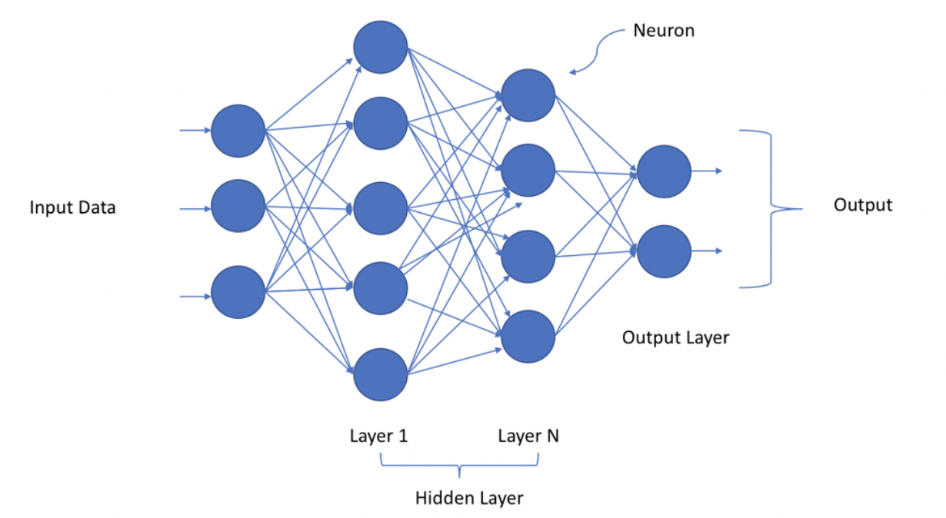

Slide 6
Tuning of DNN
There are many techniques used to tune our neural network.
Normalizing Data
Supplying more Data
Changing the weights
Changing the activation function
Increasing the number of neurons
Increase hidden layers

Slide 7
Important terms
Forward Propagation- The input X provides the initial information that then propagates to the hidden units at each layer and finally produce the output y.
Backward Propagation- Allows the information to go back from the cost backward through the network in order to compute the gradient.
Loss- Loss is nothing but a prediction error of Neural Network and the method to calculate the loss is called Loss Function.
Metrics- A metric is a function that is used to judge the performance of your model.
Accuracy- The ratio of all correct predictions to all predictions.

Slide 8

Transfer Functions
Sigmoid Function-
It’s recommended to be used only on the output layer so that we can easily interpret the output as probabilities since it has restricted output between 0 and 1.
One of the main disadvantages for using sigmoid function on hidden layers is that the gradient is very close to zero over a large portion of its domain which makes it slow and harder for the learning algorithm to learn.

Slide 9

Transfer function
ReLU-
It stands for REctified Linear Unit.
The models that are close to linear are easy to optimize.
Since ReLU shares a lot of the properties of linear functions, it tends to work well on most of the problems.

Slide 10
Transfer Function
Tanh-
It’s superior to sigmoid function in which the mean of its output is very close to zero.
The disadvantage that it shares with sigmoid function is that the gradient is very small on good portion of the domain.

Slide 11
More related terms
Underfit- An underfit machine learning model is not a suitable model and will be obvious as it will have poor performance on the training data.
Overfit- Overfitting happens when a model learns the detail and noise in the training data to the extent that it negatively impacts the performance of the model on new data.
Optimal Fit- It is the sweet spot in fitting where the error is not too big or too small.

Slide 12
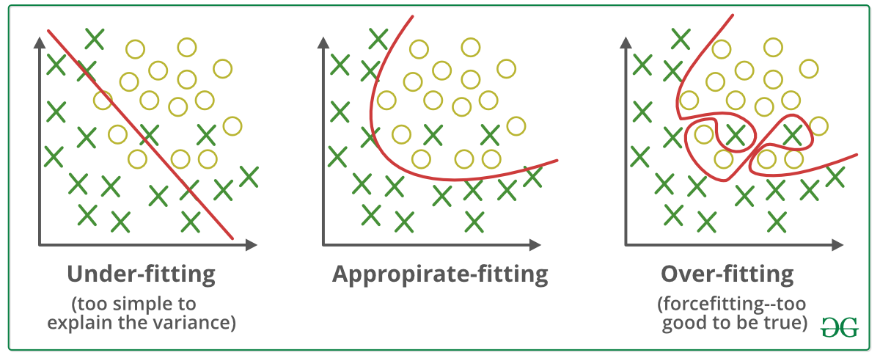

Slide 13

DROPOUT
Dropout is a technique used to prevent a model from overfitting.
Dropout works by randomly setting the outgoing edges of hidden units (neurons that make up hidden layers) to 0 at each update of the training phase.

Slide 14
Linear Regression Code
import pandas as pd import numpy as np from keras.models import Sequential from keras.layers import Dense data = pd.read_csv('Linear_Regression.csv') print(data) x = data.drop("Y", axis=1) y = data["Y"] model = Sequential() model.add(Dense(150, input_dim=1, activation="relu")) model.add(Dense(150, activation="relu")) model.add(Dense(50, activation="relu")) model.add(Dense(1)) model.compile(loss="mean_squared_error", optimizer="adam", metrics=["mean_squared_error"]) model.fit(x, y, epochs=200) x = [[400]] print(model.predict(x))

Slide 15
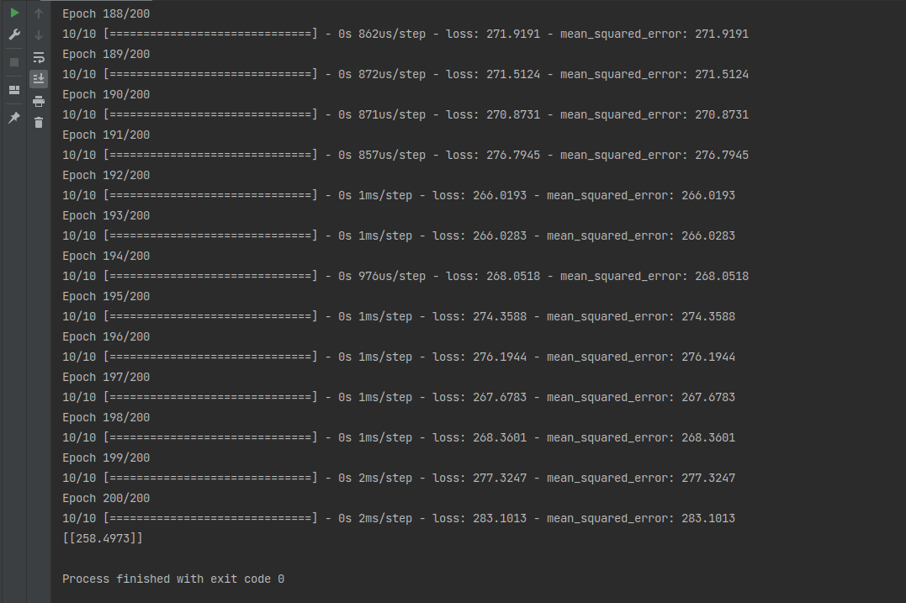
Linear Regression Output

Slide 16
Classification Code
import pandas as pd from keras.models import Sequential from keras.layers import Dense data = pd.read_csv('diabetes.csv') print(data) x = data.drop("Outcome", axis=1) y = data["Outcome"] model = Sequential() model.add(Dense(100, input_dim=8, activation="relu")) model.add(Dense(100, activation="relu")) model.add(Dense(1, activation="sigmoid")) model.compile(loss="binary_crossentropy", optimizer="adam", metrics=["accuracy"]) model.fit(x, y, epochs=159, batch_size=10) _, accuracy = model.evaluate(x, y) print("Model accuracy: %.2f" % (accuracy * 100)) predictions = model.predict(x) print([round(x[0]) for x in predictions])

Slide 17
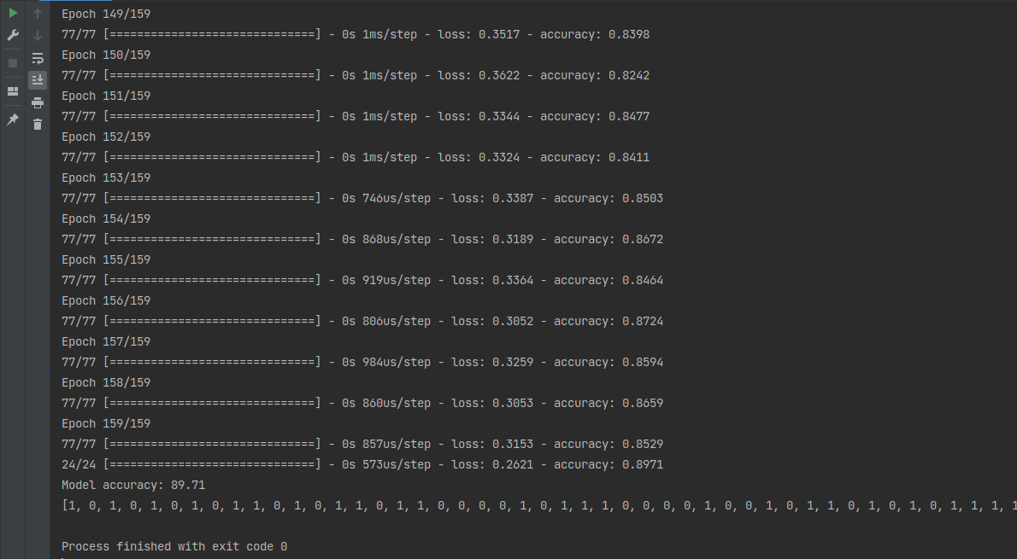
Classification output

